Slide 1
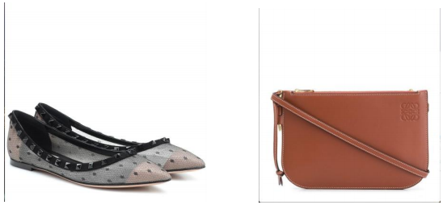
Fashion Item Classification using Deep Learning
GGbond
Xinyang Chen (z5435860)
Jinqi Li(z5405141)
Chengduo Di (z5398380)
Po-Hsun Chang (z5408868)
Sipeng Wang(z5499235)

Slide 2
Motivation
Content:
Image Classification: Identifying which category the image belongs to
Core Task in Computer Vision
Broad Array of Applications:
Social media
Intelligent Transport System
Medical
Presenter: Xinyang Chen (z5435860)

Slide 3
Problem Statement
Content:
Develop a deep learning-based image classification model using ResNet34, VGG16.
For TaskA, The model should accurately classify fashion items into four main categories: Shoes, Clothing, Accessories, Bags.
For TaskB we need to classify 34 subclasses
Within each main category, the model should further classify items into specific subcategories.
Presenter: Xinyang Chen (z5435860)

Slide 4
Literature Review
Summary of Relevant Papers:
Paper 1: “Deep Residual Learning for Image Recognition” by Kaiming He et al.
Key Points:
Introduction of ResNet architecture
Impact of residual learning on image recognition
Performance improvements over traditional CNNs
Paper2: Transfer learning using VGG-16 with Deep Convolutional Neural Network for Classifying Images by Srikanth Tammina
Key Points:
Uses one of the pre-trained models
VGG - 16 with Deep Convolutional Neural Network to classify images.
Presenter: Xinyang Chen (z5435860)

Slide 5
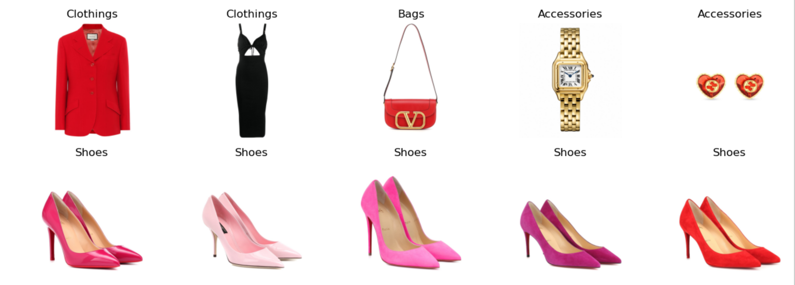
Dataset(s)
The UT Fashion 100 dataset consists of two parts: AAT and LAT. Base on the requirement, for taskA we classify items into 4 main categories, and for taskB we classify items into 31 subclass.
Presenter: Jinqi Li (z5405141)

Slide 6
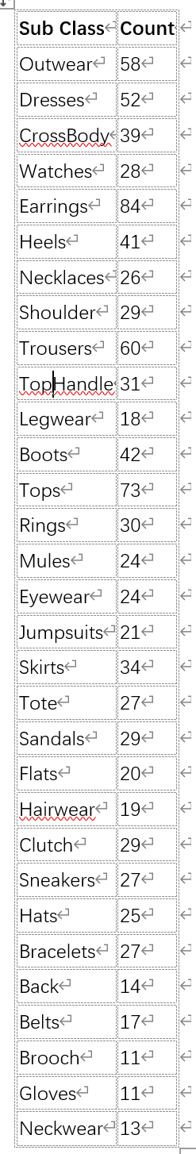
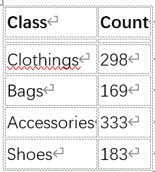

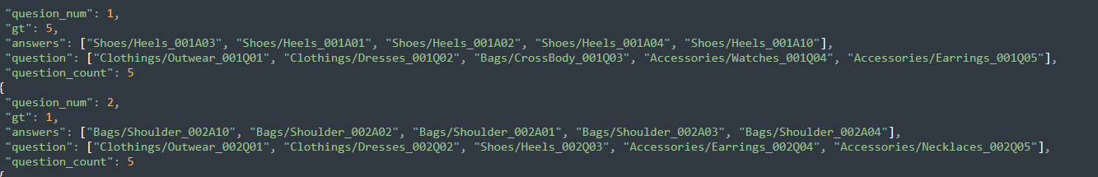
Dataset(s)
the data is small and unbalanced
AAT
AAT: main class + subclass + picture name
LAT: 7427 number of images, but only 680 images include label
So we choose AAT for classification
Presenter: Jinqi Li (z5405141)

Slide 7
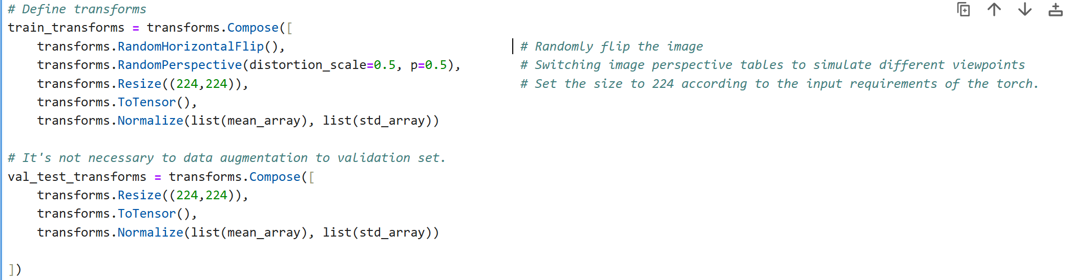
Data preprocessing
# Standardised using mean and standard deviation
AAT inputs all images as 983*1044 pixels. For such a big picture, the gpu requirement is higher, so in the preprocessing part we set it to 224*224 pixel size.
Data preprocessing: includes data augmentation (random level flipping and perspective transformations) and normalisation.
Data augmentation helps to increase the diversity of the training data and prevent model overfitting.
Presenter: Jinqi Li (z5405141)

Slide 8
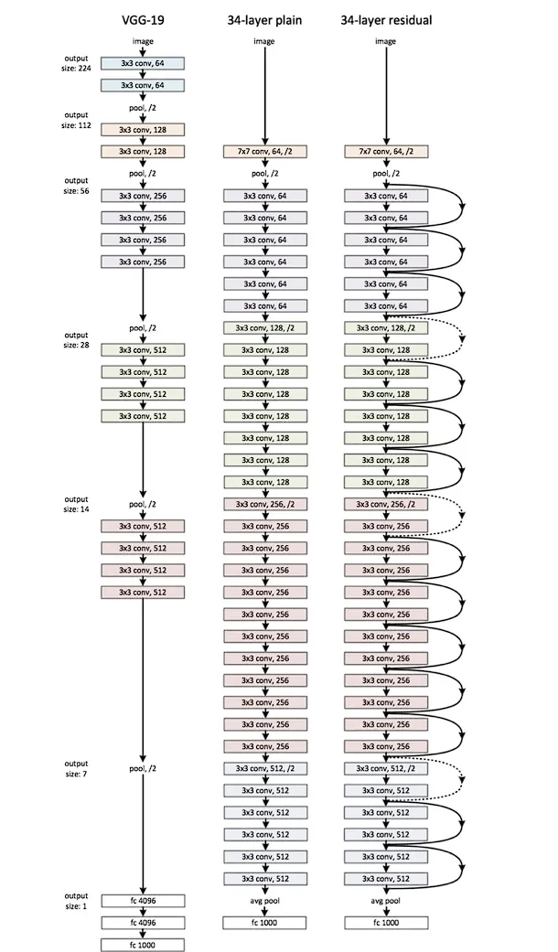
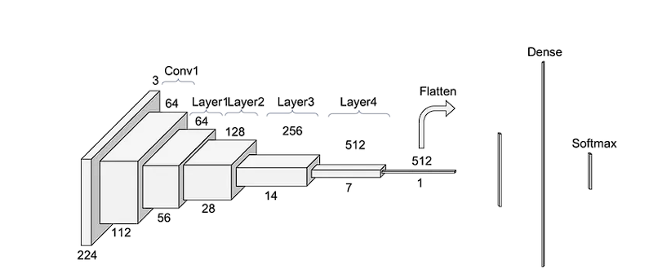
Method(Resnet34)
Key Components:
Input Layer: 7x7 convolution with 64 filters, stride 2 + 3x3 max pooling, stride 2.
Residual Blocks:
3 blocks of 3 layers
4 blocks of 4 layers
6 blocks of 6 layers
3 blocks of 3 layers
Output Layer: Global average pooling + fully connected layer.
Overview :
Developed by: Kaiming He et al. in 2015.
Architecture: 34-layer deep convolutional neural network.
Key Feature: Uses residual connections to mitigate vanishing gradient problems.
Applications: Image classification, object detection, image segmentation, feature extraction.
Presenter: Chengduo Di (z5398380)

Slide 9

Method(Resnet34)
Input: 983 images
Task A: divide them into 4 main classes
quite easy!
It is easy to achieve more than 80 percent accuracy
Task B: divide them into 31 sub classes
Unbalanced data: Sample proportionately from each subclass
Too little data: ??
Which may lead to:
Overfitting, Poor Generalization, High Variance, Inaccurate Estimates of Model Performance, Bias in Data, Inability to Capture Rare Events…
Presenter: Chengduo Di (z5398380)

Slide 10
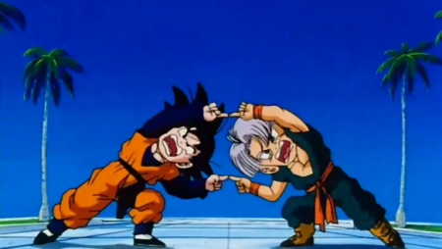
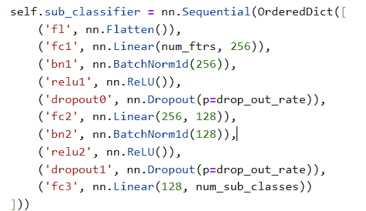
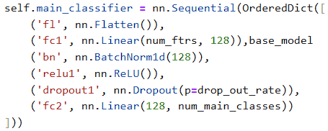
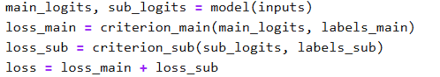
Method(Resnet34)
Input
Multitask learning
Share layer
self.base_model = models.resnet34(weights=None)
# Get the number of features from the last convolutional layer of ResNet34 num_ftrs = 512
# The last convolutional layer of ResNet34 outputs 512 features
self.base_model.fc = nn.Identity()
# Remove the fully connected layer to directly output aggregated features
Task A specific layer
Task B specific layer
Task A
Task B
Combined Loss Function
Since it needs to classify more classes, it is designed to be deeper
Fully connected layer to reduce dimensionality
Batch normalization for stable training and faster convergence
ReLU activation function for non-linearity
Dropout for regularization to prevent overfitting
Fully connected layer to produce logits for main classes
Presenter: Chengduo Di (z5398380)

Slide 11
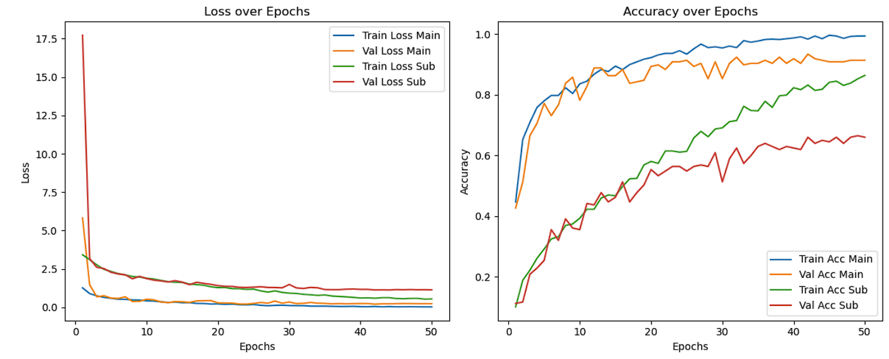
Results(Resnet34)
Main Task Performance:
Loss: Both training and validation loss
decrease and stabilize at low values,
indicating effective learning and
good generalization.
Accuracy: High and stable training and
validation accuracy, suggesting strong
model performance on the main task.
Sub-Task Performance:
Loss: Higher training and validation loss compared to the main task, indicating the sub-task is more challenging.
Accuracy: Lower and more fluctuating training and validation accuracy, suggesting difficulties in generalization and complexity in the sub-task.
General Observations:
Effective Learning: The model learns the main task effectively with good generalization.
Improvement Needed: Further tuning may be required to enhance performance on the sub-task, such as using more data or different architectures.
the prediction accuracy of main class is 91.37%, and the prediction accuracy of subclass is 65.99%
Presenter: Chengduo Di (z5398380)

Slide 12
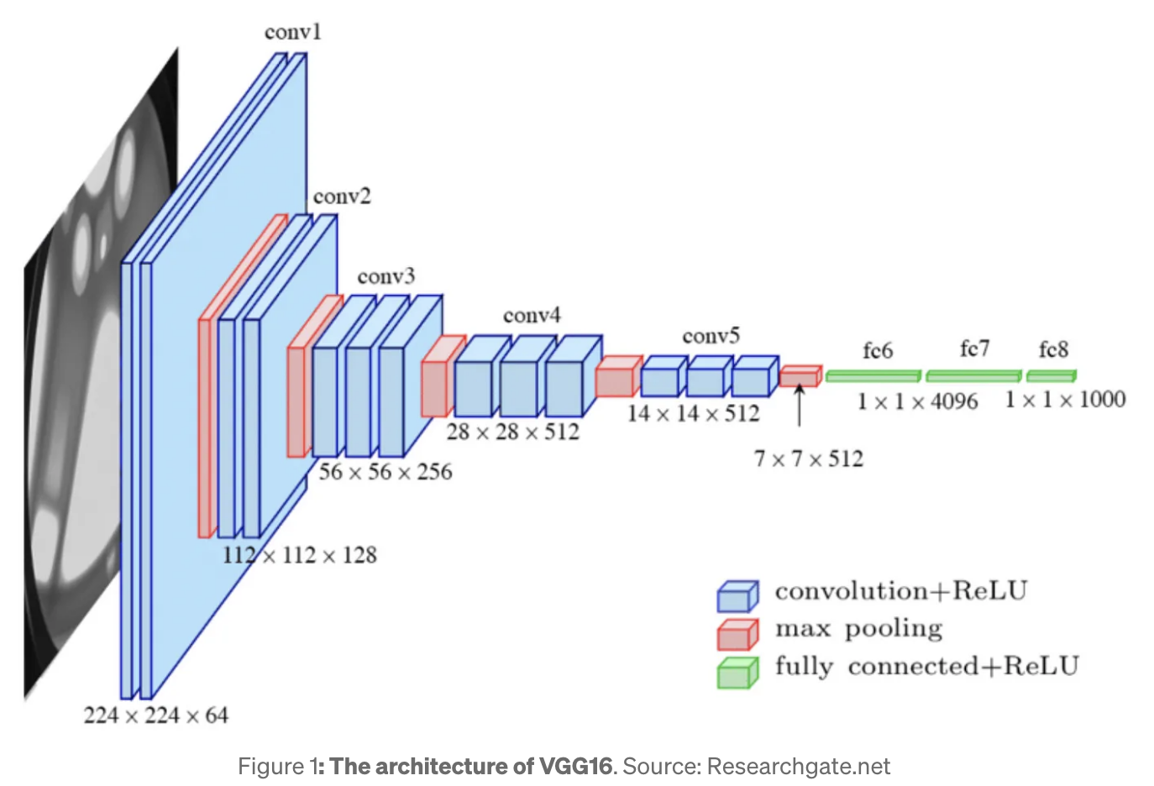
Method(VGG)
The VGG model is shallower than Resnet
The residual block will not be added to each step of increasing the dimension
Every three convolution layers + max poor layers will reduce the length and width of each channel by half.
Presenter: Po-Hsun Chang (z5408868)

Slide 13
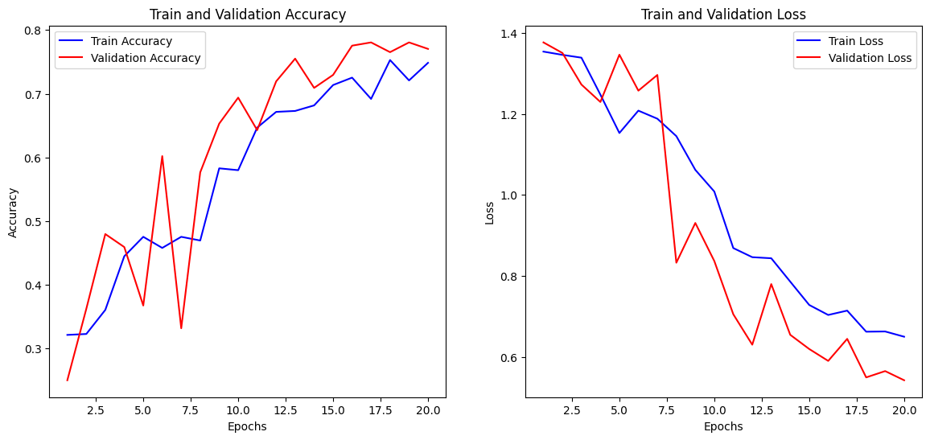
Results(taskA)
For task A classify 4 classes using the same parameter as Resnet (ex. transforms)
Training and Validation accuracy after 15 epoch will be around 70%, final validation accuracy is 77%
Training and Validation loss steadily decrease
Presenter: Po-Hsun Chang (z5408868)

Slide 14
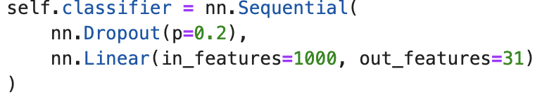
Parameter tuning(taskB)
For task B, parameter tuning of classify 31 classes
Drop out = 0.2, output 31
Augmentation only use horizontal flip
Presenter: Po-Hsun Chang (z5408868)

Slide 15
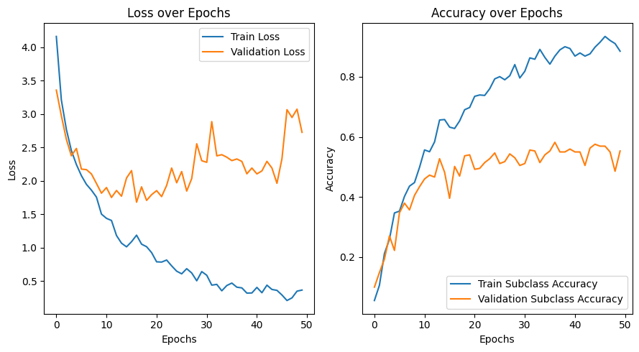
Results(taskB)
A higher overfitting problem appears after 20 epochs
However, the validation loss and validation accuracy between 20 epoch and 50 epoch are similar
Final validation accuracy is 55%
Presenter: Po-Hsun Chang (z5408868)

Slide 16
Discussion
Performance of Model
Task A (VGG series & ResNet series)
Task B (VGG16 & ResNet34)
ResNet Series(Shallow ResNet & Deep ResNet)
Shallow ResNet
Deep ResNet
Weakness & Improvements
Presenter: Sipeng Wang(z5499235)

Slide 17
Conclusion
Motivation & Problem Statement & Literature Review
Datasets & Data Analysis
Methods & Results
Discussion
Presenter: Sipeng Wang(z5499235)

Slide 18

This Photo by Unknown Author is licensed under CC BY-SA

